Slide 1
ASTRONOMY
Chapter 3: ORBITS AND GRAVITY
3.1 The Laws of Planetary Motion
3.2 Newton’s Great Synthesis
3.3 Newton’s Universal Law of Gravitation
3.4 Orbits in the Solar System
3.5 Satellite Motion
By the end of this section, you will be able to:
Describe how Tycho Brahe and Johannes Kepler contributed to our understanding of how planets move around the Sun
Explain Kepler’s three laws of planetary motion

Slide 2
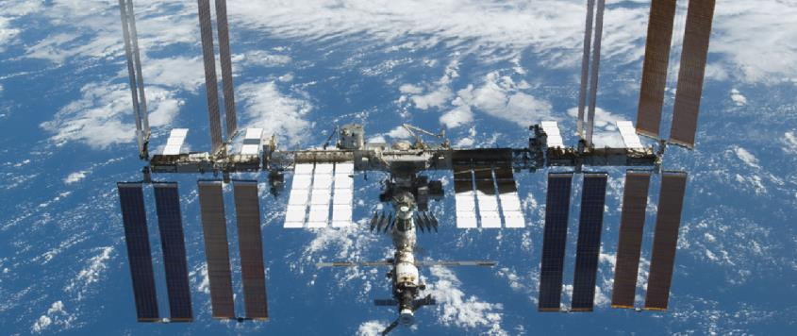
International Space Station. This space habitat and laboratory orbits Earth once every 90 minutes. (credit: modification of work by NASA)
240 miles above the Earth’s Surface
Speed: 17000 miles/hour
Orbital period: 93 minutes

Slide 3
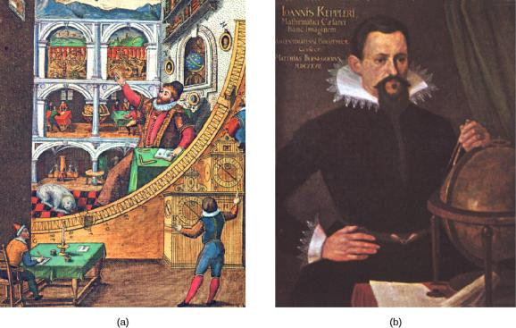
Tycho Brahe - Johannes Kepler - Isaac Newton
Tycho Brahe (1546–1601)
A stylized engraving shows Tycho Brahe using his instruments to measure the altitude of celestial objects above the horizon. The large curved instrument in the foreground allowed him to measure precise angles in the sky. Note that the scene includes hints of the grandeur of Brahe’s observatory at Hven.
Brahe made a continuous record of the positions of the Sun, Moon, and planets for almost 20 years.
From Denmark, he moved to Prague where he met a most able young mathematician, Johannes Kepler, to assist him in analyzing his extensive planetary data.

Slide 4
Tycho Brahe - Johannes Kepler - Isaac Newton
Kepler was a German mathematician and astronomer. His discovery of the basic laws that describe planetary motion placed the heliocentric cosmology of Copernicus on a firm mathematical basis.
He attended university at Tubingen and studied for a theological career.
There, he learned the principles of the Copernican system and became converted to the heliocentric hypothesis.
Eventually, Kepler went to Prague to serve as an assistant to Brahe, who set him to work trying to find a satisfactory theory of planetary motion — one that was compatible with the long series of observations made at Hven.
Johannes Kepler (1571–1630)
Through his analysis of the motions of the planets, Kepler developed a series of principles, now known as Kepler’s three laws, which described the behavior of planets based on their paths through space. The first two laws of planetary motion were published in 1609 in The New Astronomy.
Their discovery was a profound step in the development of modern science.

Slide 5
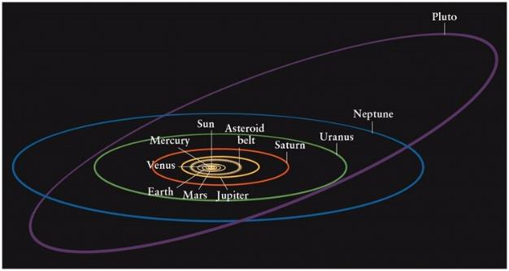
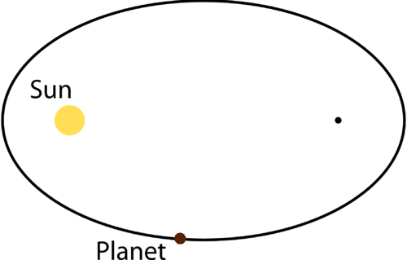
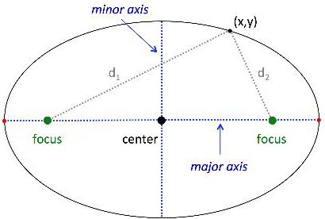
Laws of planetary motion Ellipse
Orbit: The path of an object through Space
Circle: a round shape, whose circumference is equidistant from the center
Ellipse: an oval shape (flattened circle)
Major axis: the widest diameter of the ellipse
Semimajor axis (a): half the major axis, distance from the center of the ellipse to one end
Eccentricity (e): the ratio of the distance between the foci to the length of the major axis
e values: 0 – 1
e = 0 is a circle
e = 1 is the most eccentric orbit
Working with the data for Mars, Kepler discovered that its Orbit is an Ellipse.

Slide 6
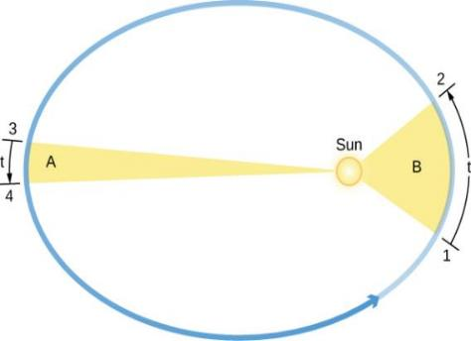
Laws of planetary motion
Kepler’s first Law:
The orbits of all the planets are Ellipses
Kepler’s Second Law: the law of equal areas
In equal intervals of time (t), the areas swept out in space by a line (virtual) joining Planet and Sun are always equal.
The area of the region B from 1 to 2 is the same as that of region A from 3 to 4.
Kepler discovered that the planet speeds up as it comes closer to the Sun and slows down as it pulls away from the Sun. He expressed the precise form of this relationship by imagining that the Sun and Mars are connected by a straight, elastic line.
The orbital speed of a planet traveling around the Sun (the circular object inside the ellipse) varies in such a way that in equal intervals of time (t), a line between the Sun and a planet sweeps out equal areas (A and B). Note that the eccentricities of the planets’ orbits in our Solar System are substantially less than shown here.

Slide 7
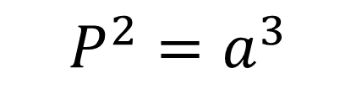
Laws of planetary motion
Kepler’s Third Law:
A planet’s orbital period squared is proportional to the semimajor axis of its orbit cubed.
$$P^{2}=a^{3}$$
Orbital Period: the time it takes a planet to travel once around the Sun.
P is measured in years
a is measured in AU (astronomical unit)
Kepler’s third law applies to all objects orbiting the Sun, including Earth, and provides a means for calculating their relative distances from the Sun from the time they take to orbit.
The orbital speed of a planet traveling around the Sun (the circular object inside the ellipse) varies in such a way that in equal intervals of time (t), a line between the Sun and a planet sweeps out equal areas (A and B). Note that the eccentricities of the planets’ orbits in our Solar System are substantially less than shown here.

Slide 8
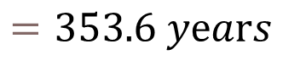
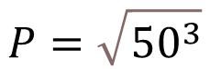
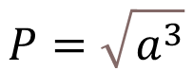
Laws of planetary motion
Kepler’s Third Law:
A planet’s orbital period squared is proportional to the semimajor axis of its orbit cubed.
$$P^{2}=a^{3}$$
Example:
Imagine an object is traveling around the Sun. What would be the orbital period of the object if its orbit has a semimajor axis of 50 AU?
The orbital speed of a planet traveling around the Sun (the circular object inside the ellipse) varies in such a way that in equal intervals of time (t), a line between the Sun and a planet sweeps out equal areas (A and B). Note that the eccentricities of the planets’ orbits in our Solar System are substantially less than shown here.
$$P=\sqrt{a^{3}}$$
$$P=\sqrt{{50}^{3}}$$
$$=353.6 yⅇars$$

Slide 9

Laws of planetary motion
Kepler’s three laws of planetary motion can be summarized as follows:
Kepler’s first law: Each planet moves around the Sun in an orbit that is an ellipse, with the Sun at one focus of the ellipse.
Kepler’s second law: The straight line joining a planet and the Sun sweeps out equal areas in space in equal intervals of time.
Kepler’s third law: The square of a planet’s orbital period is directly proportional to the cube of the semimajor axis of its orbit.
Kepler’s three laws provide a precise geometric description of planetary motion within the framework of the Copernican system. With these tools, it was possible to calculate planetary positions with greatly improved precision. Still, Kepler’s laws are purely descriptive: they do not help us understand what forces of nature constrain the planets to follow this particular set of rules. That step was left to Isaac Newton.

Slide 10
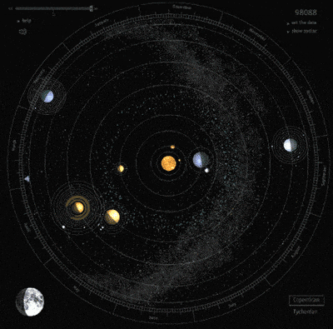
Chapter 3: ORBITS AND GRAVITY
3.1 The Laws of Planetary Motion
3.2 Newton’s Great Synthesis
3.3 Newton’s Universal Law of Gravitation
3.4 Orbits in the Solar System
3.5 Satellite Motion
By the end of this section, you will be able to:
Describe Newton’s three laws of motion
Explain how Newton’s three laws of motion relate to momentum
Define mass, volume, and density and how they differ
Define angular momentum
Explain what determines the strength of gravity
Describe how Newton’s universal law of gravitation extends our understanding of Kepler’s laws

Slide 11
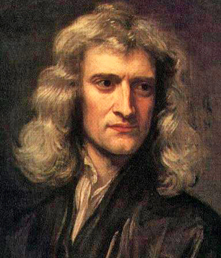
Tycho Brahe - Johannes Kepler - Isaac Newton
It was the genius of Isaac Newton that found a conceptual framework that completely explained the observations and rules assembled by Galileo, Brahe, Kepler, and others.
Newton was born in Lincolnshire, England, in the year after Galileo’s death (January 4, 1643)
His mom wanted him to be a farmer.
He discovered Gravity.
He entered Trinity College at Cambridge in 1661 and eight years later was appointed professor of mathematics.
Among Newton’s contemporaries in England were architect Christopher Wren, authors Aphra Behn and Daniel Defoe, and composer G. F. Handel.
He died of chemical poisoning (mercury)
Isaac Newton (1643–1727)
His work on the laws of motion, gravity, optics, and mathematics laid the foundations for much of physical science.

Slide 12


Slide 13
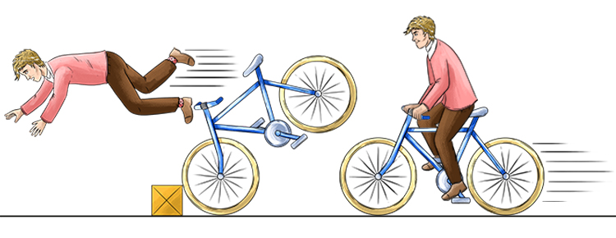
Newton’s laws of motion
Newton published Philosophiae Naturalis Principia Mathematica → Principia (1687)
Newton proposed three laws that would govern the motions of all objects:
Newton’s First Law: Every object will continue to be in a state of rest or move at a constant speed in a straight line unless it is compelled to change by an outside force.
Your body moves forward when you suddenly apply brakes while driving
Restatement of Galileo’s discovery: Conservation of Momentum
Momentum is the product of mass and velocity; therefore, it is the measure of a body’s motion.
The momentum of a body can change only
under the action of an outside influence.

Slide 14
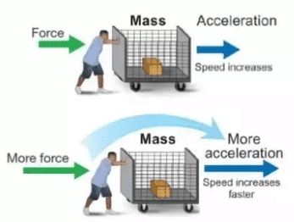
Newton’s laws of motion
Newton published Philosophiae Naturalis Principia Mathematica → Principia (1687)
Newton proposed three laws that would govern the motions of all objects:
Newton’s Second Law: The change of motion of a body is proportional to and in the direction of the force acting on it.
Part 1: Acceleration of an object is directly proportional to the Force acting on it
Part 2: … inversely proportional to the object’s mass
F = ma
Where F = force, m = mass, a = acceleration

Slide 15
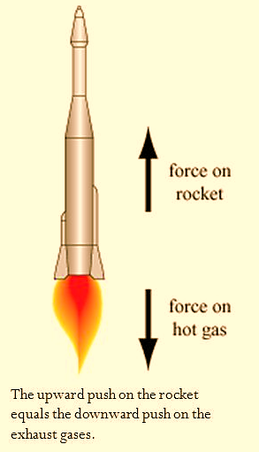
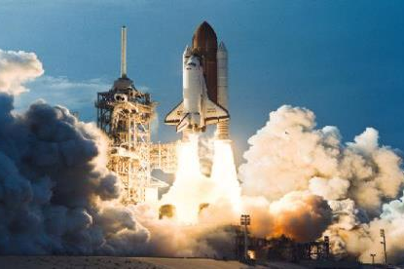
Newton’s laws of motion
Newton published Philosophiae Naturalis Principia Mathematica → Principia (1687)
Newton proposed three laws that would govern the motions of all objects:
Newton’s Third Law: For every action there is an equal and opposite reaction
The mutual actions of two bodies upon each other are always
equal and act in opposite directions.
Demonstrating Newton’s Third Law. The U.S. Space Shuttle (here launching Discovery), powered by three fuel engines burning liquid oxygen and liquid hydrogen, with two solid fuel boosters, demonstrates Newton’s third law. (credit: modification of work by NASA)

Slide 16
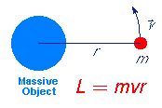

More physical quantities …
Mass: is a measure of the amount of material within an object.
unit: kilogram (kg)
Volume: measure of the physical space an object occupies.
unit: cubic meter (m³)
Density: measure of compactness of an object (mass/volume).
unit: kg/m³
Angular Momentum: measure of the rotation of a body as it revolves around some fixed point (an example is a planet orbiting the Sun).
Angular Momentum = mass x velocity x radius (mvr)
Conservation of Angular Momentum: [mvr]_{A} = [mvr]_{B}

Slide 17
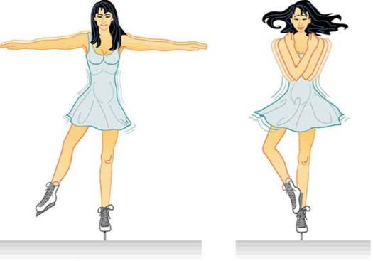
Conservation of angular momentum
Conservation of Angular Momentum. When a spinning figure skater brings in her arms, their distance from her spin center is smaller, so her speed increases. When her arms are out, their distance from the spin center is greater, so she slows down.

Slide 18
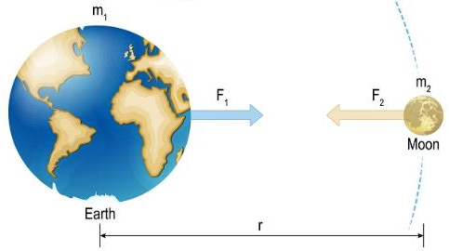
Newton’s universal law of gravitation
Newton’s laws of motion show that objects at rest will stay at rest and those in motion will continue moving uniformly in a straight line unless acted upon by a force.
Thus, it is the straight line that defines the most natural state of motion.
But the planets move in ellipses, not straight lines; therefore, some force must be bending their paths.
That force, Newton proposed, was gravity.
If you drop something, it accelerates toward Earth as it falls. Newton’s insight was that Earth’s gravity might extend as far as the Moon and produce the force required to curve the Moon’s path from a straight line and keep it in its orbit.
He further hypothesized that gravity is not limited to Earth, but that there is a general force of attraction between all material bodies.
If so, the attractive force between the Sun and each of the planets could keep them in their orbits.

Slide 19
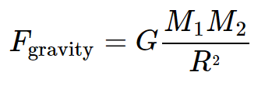
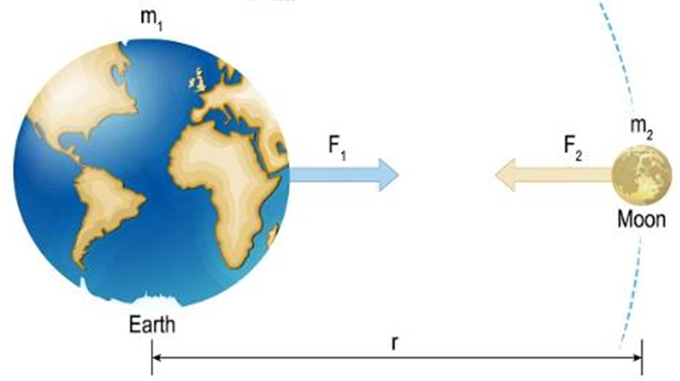
Newton’s universal law of gravitation
The magnitude of the force of gravity must decrease with increasing distance between the Sun and a planet (or between any two objects) in proportion to the inverse square of their separation.
The gravitational attraction between two bodies must be proportional to their masses. The more mass an object has, the stronger the pull of its gravitational force.
where F_{gravity} is the gravitational force between two objects, M1 and M2 are the masses of the two objects, and R is their separation. G is a constant number known as the universal gravitational constant G = 6.674×10⁻¹¹ m³⋅kg⁻¹⋅s⁻²
The force of gravity on the surface of the Earth that gives us our sense of weight.
Weight = mass x gravity (mg) where g = 9.8 m/s/s

Slide 20
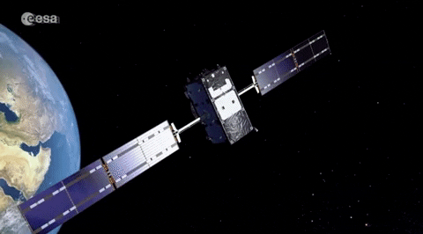
Chapter 3: ORBITS AND GRAVITY
3.1 The Laws of Planetary Motion
3.2 Newton’s Great Synthesis
3.3 Newton’s Universal Law of Gravitation
3.4 Orbits in the Solar System
3.5 Satellite Motion
By the end of this section, you will be able to:
Compare the orbital characteristics of the planets in the Solar System
Compare the orbital characteristics of asteroids and comets in the Solar System
Explain how an object (such as a satellite) can be put into orbit around Earth
Explain how an object (such as a planetary probe) can escape from orbit

Slide 21
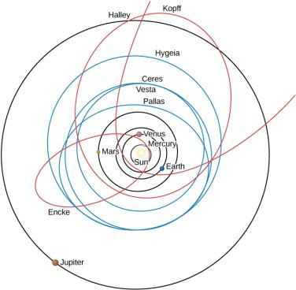
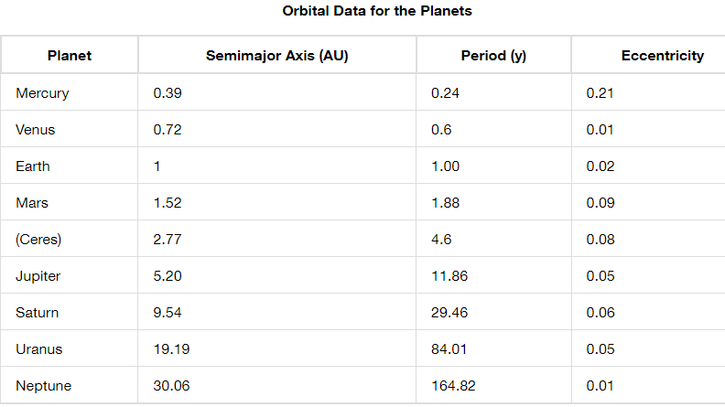
Solar System Orbits
Mercury has orbital period of 88 Earth-days (speed 48 km/s).
Mercury has the most eccentric orbit.
Neptune has orbital period of 165 years (speed: 5 km/s).
Mars has second highest eccentricity, which allowed Brahe and Kepler to predict an eccentric orbit.
Pluto’s orbit is inclined at 17 degrees, Mercury: 7 degrees
We see the orbits of typical comets and asteroids compared with those of the planets Mercury, Venus, Earth, Mars, and Jupiter (black circles). Shown in red are three comets: Halley, Kopff, and Encke. In blue are the four largest asteroids: Ceres, Pallas, Vesta, and Hygeia.

Slide 22
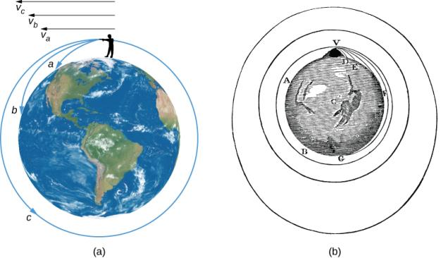
Firing a Bullet into Orbit
Newton’s universal law of gravitation and Kepler’s laws describe the motions of Earth satellites and interplanetary spacecraft as well as the planets.
Once an artificial satellite is in orbit (Sputnik from Russia was the first one), its behavior is no different from that of a natural satellite, such as our Moon.
If our bullet is given a high enough muzzle velocity, vc, the curved surface of Earth causes the ground to remain the same distance from the bullet so that the bullet falls around Earth in a complete circle. The speed needed to do this—called the circular satellite velocity—is about 8 kilometers per second, or about 17,500 miles per hour.
Firing a Bullet into Orbit.
For paths a and b, the velocity is not enough to prevent gravity from pulling the bullet back to Earth; in case c, the velocity allows the bullet to fall completely around Earth.
This diagram by Newton in his De Mundi Systemate, 1731 edition, illustrates the same concept shown in (a).

Slide 23
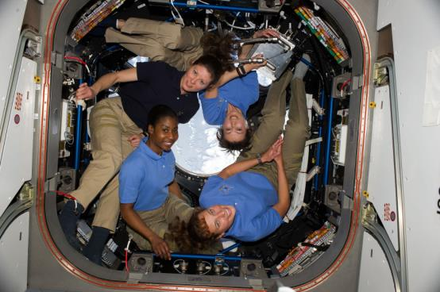
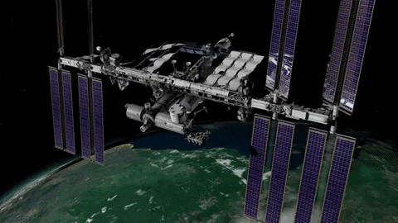
Astronauts in Free Fall
While in space, astronauts are falling freely, so they experience “weightlessness.” Clockwise from top left: Tracy Caldwell Dyson (NASA), Naoko Yamzaki (JAXA), Dorothy Metcalf-Lindenburger (NASA), and Stephanie Wilson (NASA). (credit: NASA)

Slide 24
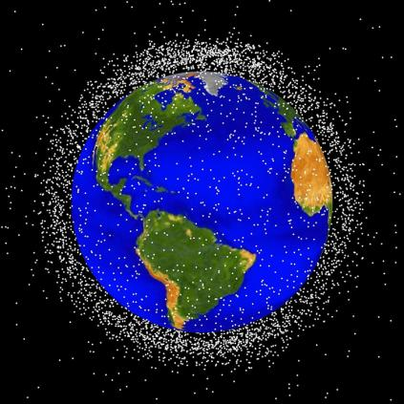
Satellites in Earth Orbit
Each year, more than 50 new satellites are launched into orbit by such nations as Russia, the United States, China, Japan, India, and Israel, as well as by the European Space Agency (ESA).
These satellites are used for weather tracking, ecology, global positioning systems, communications, and military purposes, to name a few uses.
Most satellites are launched into low Earth orbit, since this requires the minimum launch energy.
At the orbital speed of 8 kilometers per second, they circle the planet in about 90 minutes.
Some low Earth orbits are not indefinitely stable because, as Earth’s atmosphere swells from time to time, a frictional drag is generated by the atmosphere on these satellites, eventually leading to a loss of energy and “decay” of the orbit.
This figure shows the larger pieces of orbital debris that are being tracked by NASA in Earth’s orbit. (credit: NASA/JSC)

Slide 25
End of the chapter
Credit: This OpenStax ancillary resource is © Rice University under a CC-BY 4.0 International license; it may be reproduced or modified but must be attributed to OpenStax, Rice University and any changes must be noted.

